Slide 1
Intro to GitOps
Ben Mitchell | Sr. CSA | Microsoft

Slide 3


Agenda
Introductions
Getting things Setup
What is GitOps
Learn Infrastructure as Code
Intro to Git
Intro to Docker
Intro to Terraform
Intro to Ansible
Close Out

Slide 4

Introductions
Benjamin Mitchell
Sr. Cloud Solution Architect
Microsoft
Notes:
Get Name, Role, Background (operations? Dev? Help desk?)
- Talk through how those roles could benefit using GitOps/DevOps

Slide 5

Getting Setup
https://github.com/BenTheCloudGuy/msft-intro-to-gitops
Sign into GitHub to access the workshop materials.
Clone the Workshop Directory to your local machine.
Launch the GitHub Codespace for seamless development with all the tools pre-installed
Notes:
Walk through setting up GH account and launching Code Spaces.
Login: BenTheBuilder-MSFTLabs / Secure!
Getting Setup is easy with CodeSpaces.. Just need to help everyone get signed up for GitHub.
this takes several minutes the first time it creates the Codespace – show .devcontainer and talk about it.
FROM TERMINAL
docker run -it --name ‘toolbox’ -e GITHUB_TOKEN=$env:GITHUB_TOKEN -v ${PWD}:/home/vscode/.working toolbox:1.0.0

Slide 6
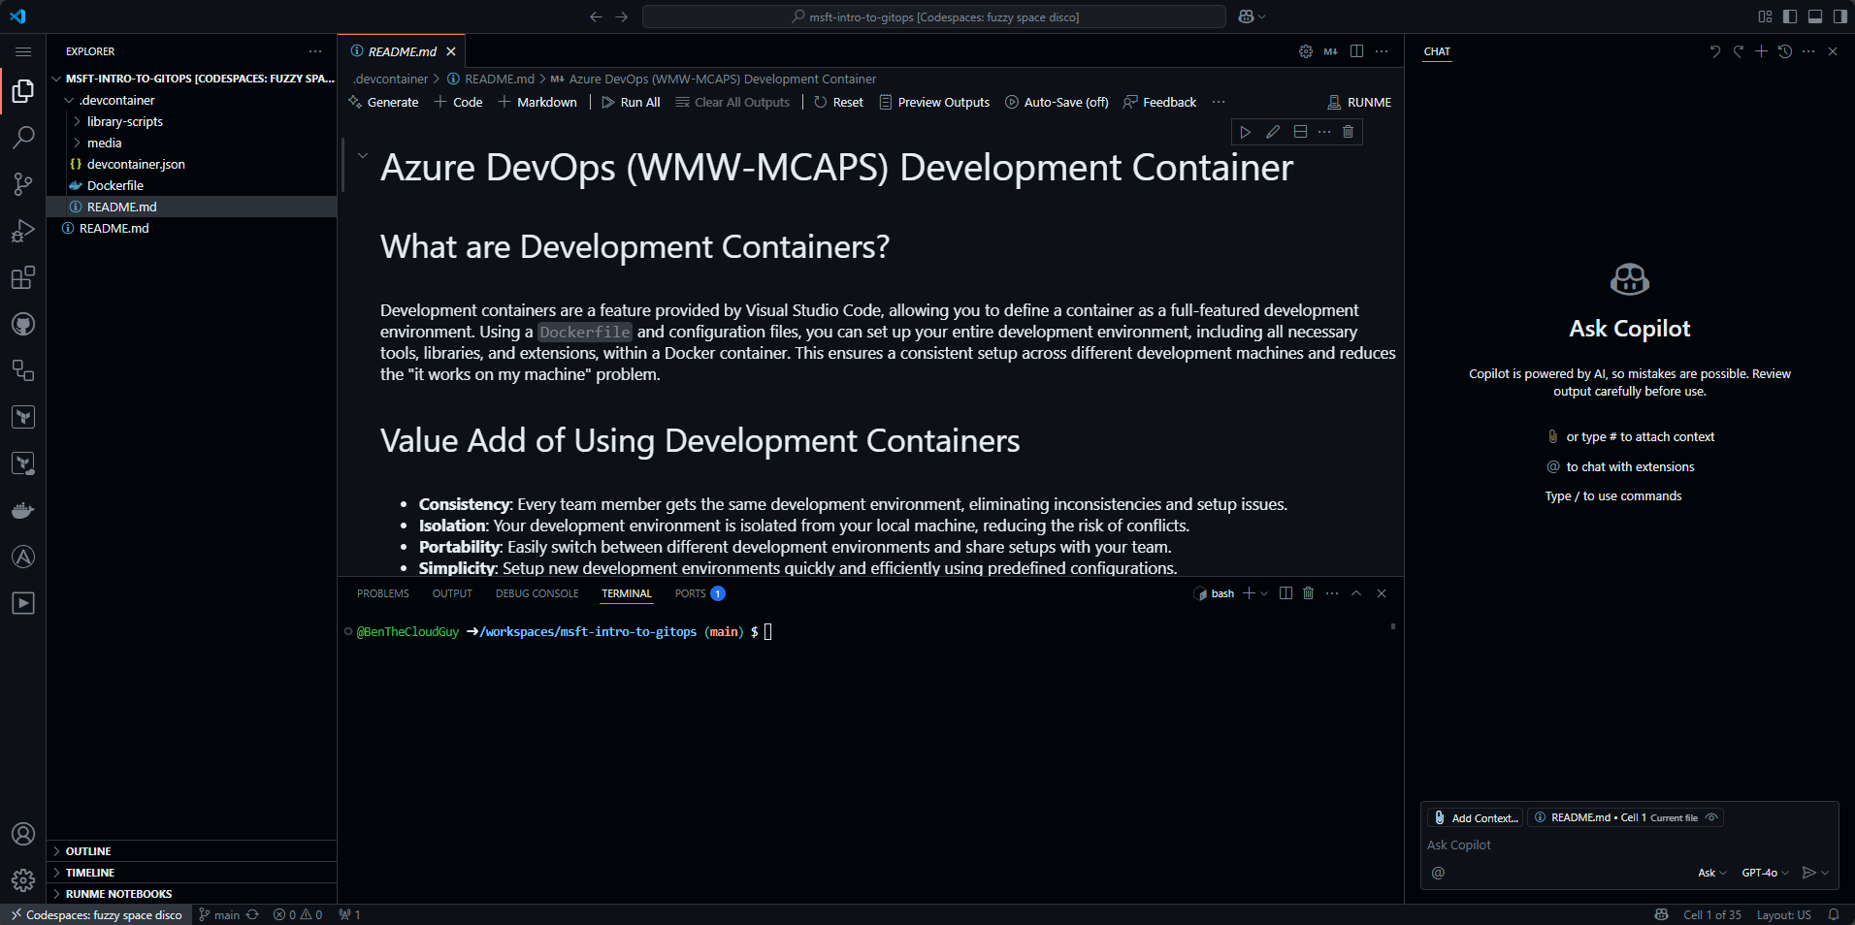
CodeSpaces and VSCode
Notes:
Walk through VSCode Interface (not a deep dive)
Create NEW Token and add as codespace secret (CONFIG_GITHUB_TOKEN) and explain why.

Slide 7








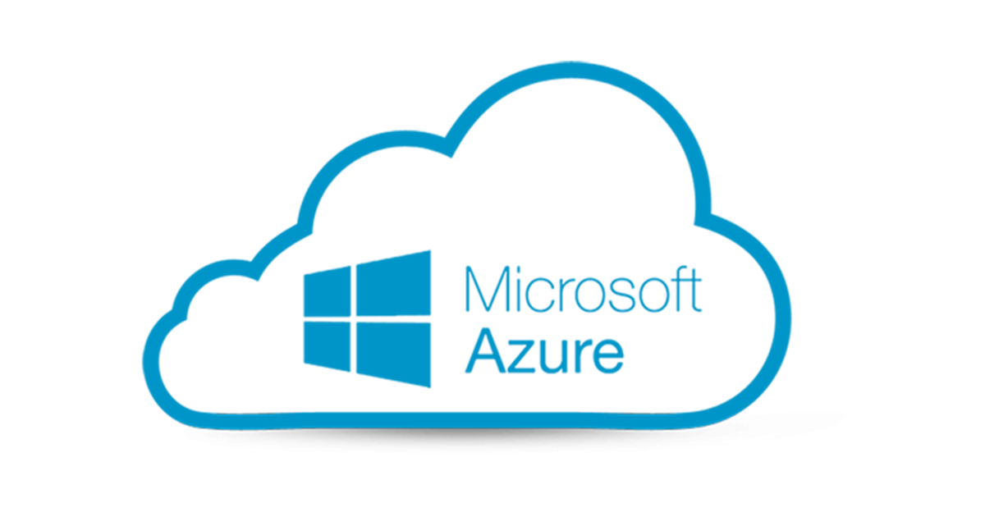
Lab Architecture
Git will be used for version Control
Use Git and Github CLI to create new repo for WebAPI and clone it down to workspace
Walk through various steps in setting up repo
Docker will be used to build NodeJS WebAPI.
Docker Image will be Stored in Github Container Registry
Docker API will be accessible via HTTP
Terraform will be used to deploy Infra:
Resources deployed to Azure
Pair of Ubuntu VMs
Azure Load Balancers with Public IP
Azure Bastion Service
Virtual Network with two subnets.
Ansible to configure hosts and app
via SSH using Azure Bastion Service (via secure tunnels)
Install Required dependencies
Install Docker
Pull Image from Github Container Registry
Github
Container
Registry
Bastion VM
Tunnels
Engineers
Azure
Bastion
HTTP
80
HTTP
80
Users
Notes:
Talk about the lab that will be built for a few moments so everyone knows what is being built.

Slide 8
What is GitOps

Slide 9
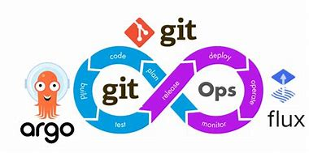
What does GitOps mean to you?
Notes:
Ask if anyone has heard of GitOps and if so what is their understanding.
Talking Point: A Mindset Shift
It’s a shift from procedural to declarative workflows. From manual to automated. Instead of logging into servers or running scripts manually, you declare it in CODE what the system should look like and store it via Git (ie version control)

Slide 10

GitOps Principles
Principle #1: Declarative.
All Infrastructure and application configuration is defined in Code.
Enable consistency, repeatability, and ease of recovery
Principle #2: Version Controlled
Every change is recorded, auditable, and revertible
Git becomes the Single Source of Truth
Allows safe rollbacks and peer-reviewed changes
Principle #3: Pulled Automatically
GitOps tools monitor the Git repo and apply updates
Pull-based model ensures security (no external push)
Principal #4: Should Reduce Drift
Ensures self-healing infrastructure
Detects and corrects manual drift or unauthorized charges
Provides observability into sync status

Slide 11
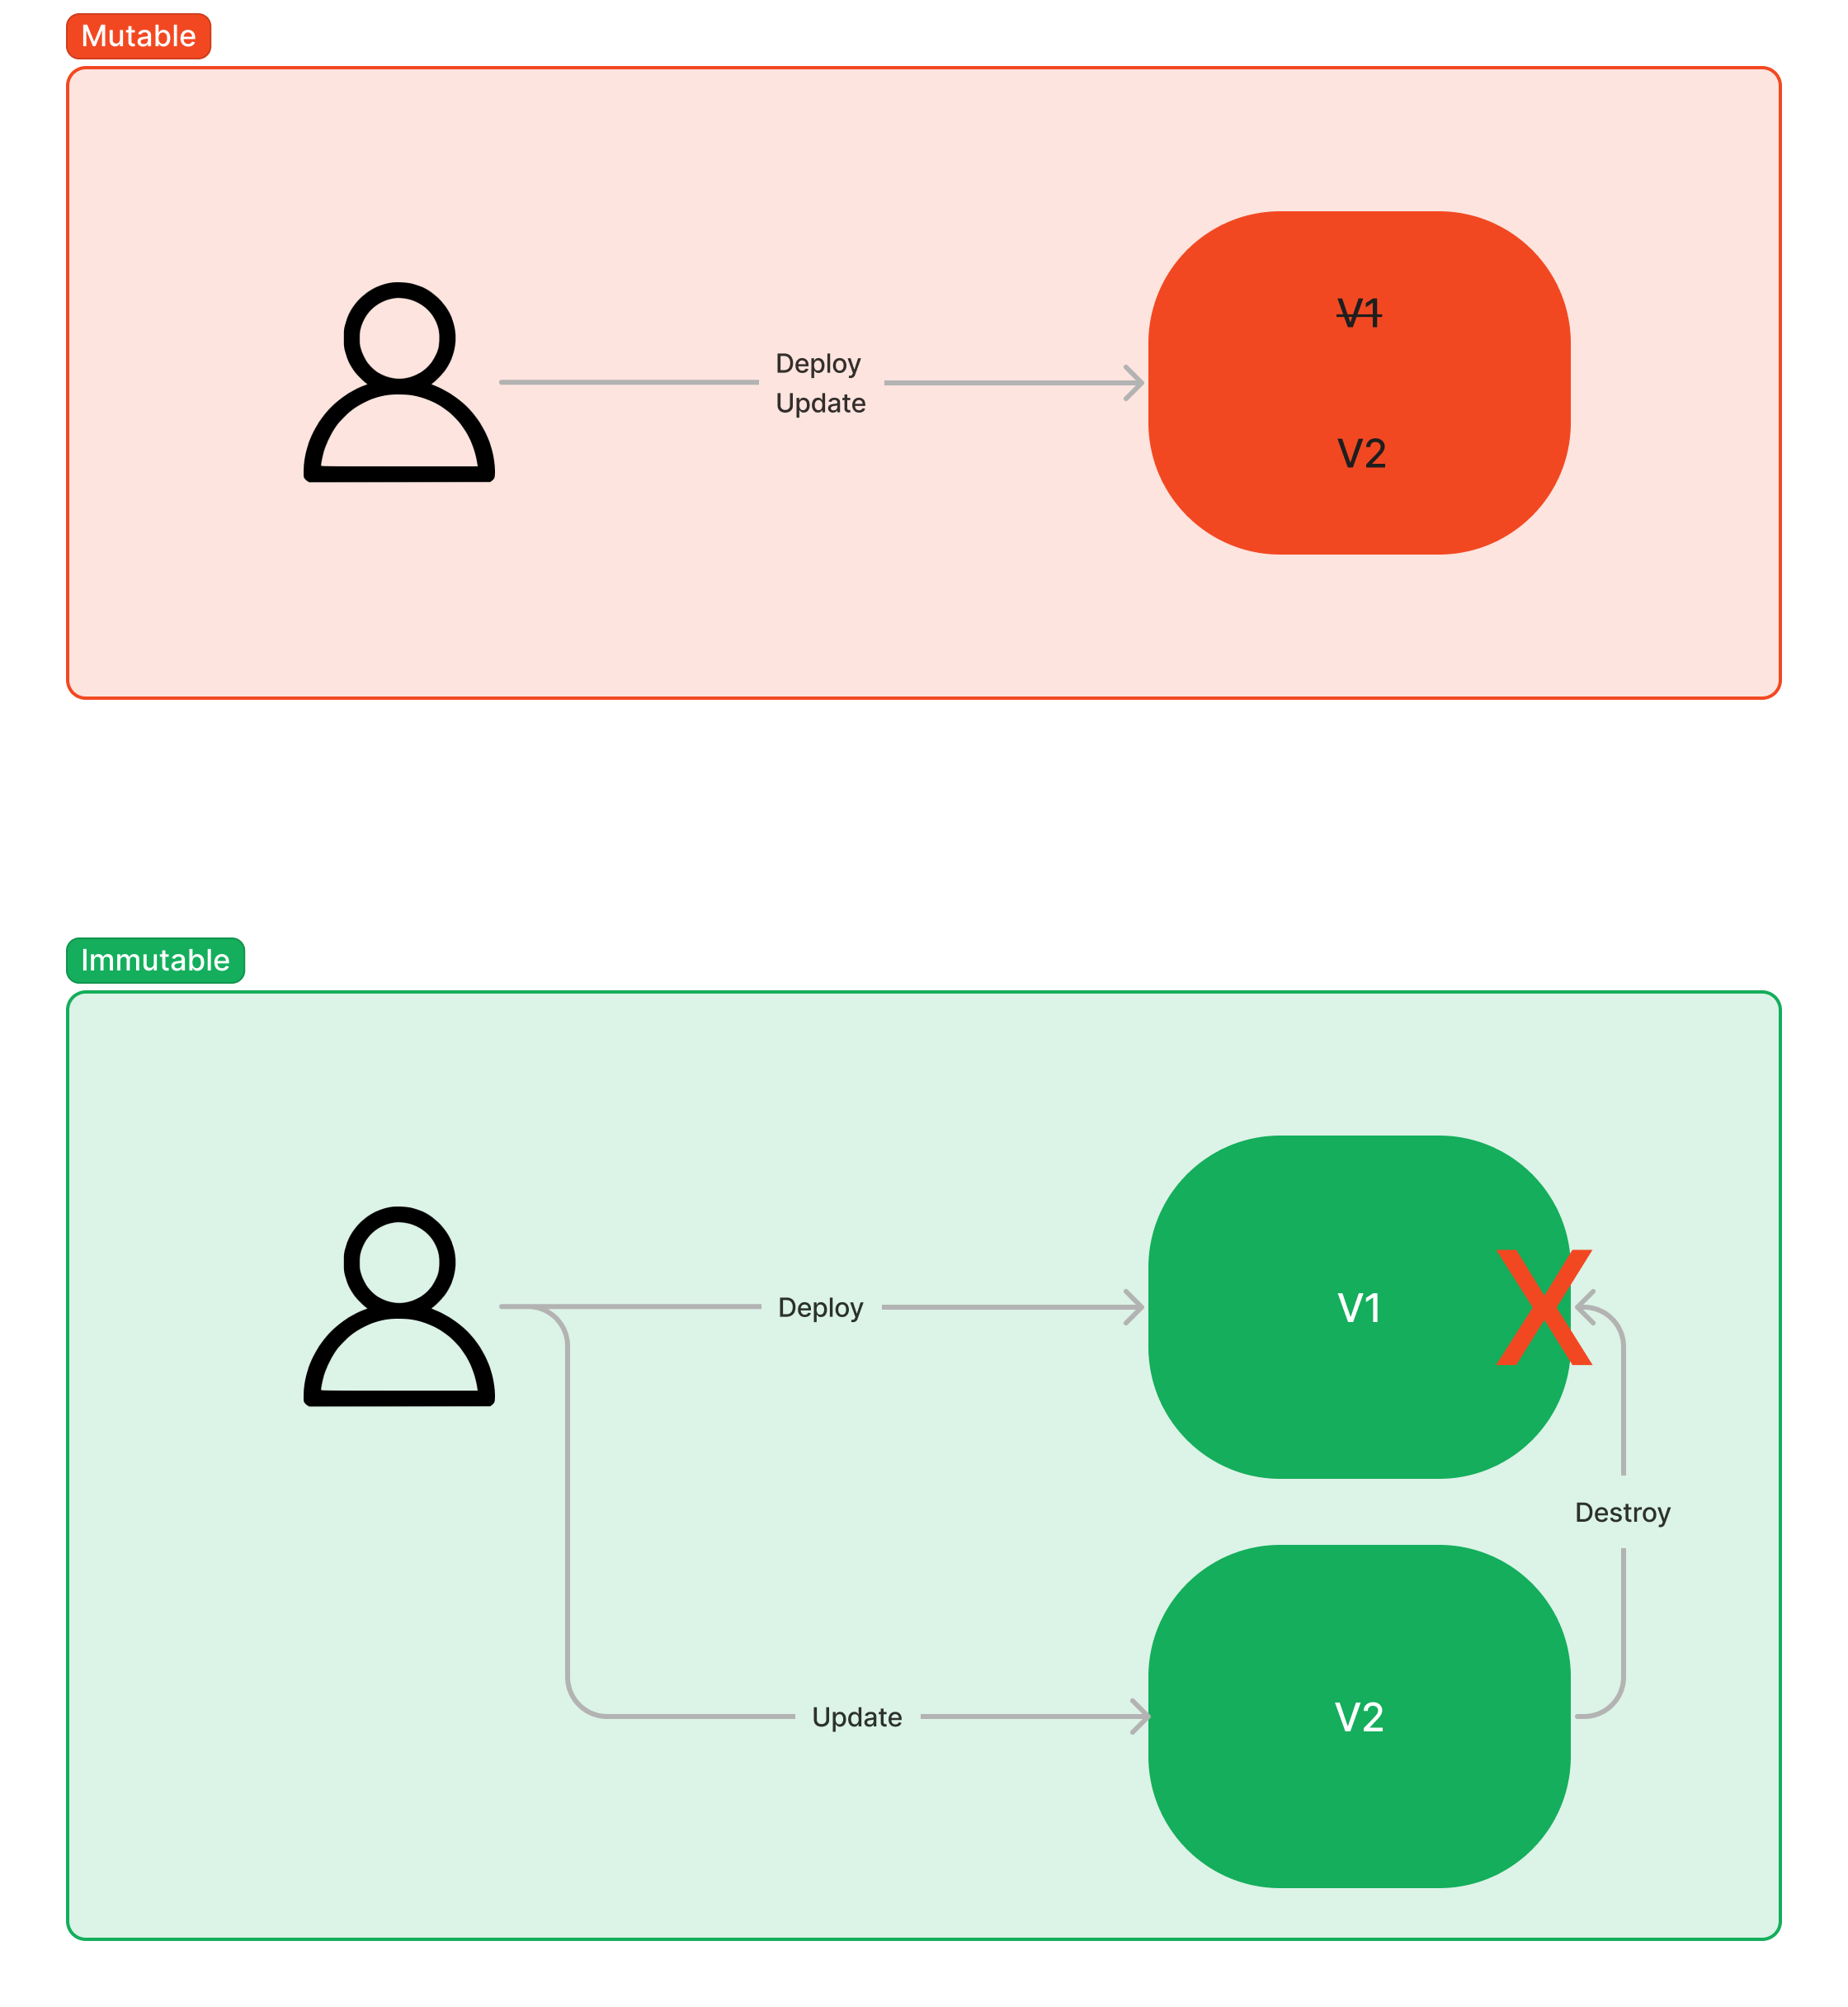
Benefits
Immutable Infrastructure
Fully Automated Systems
Prevent Manual Intervention
Everything as code
Auditability & Change Control
Improved Collaboration
Faster & Safer Deployments
Enhanced Security Posture
Multi-Environment Consistency
BC/DR built in by design

Slide 12
GitOps Architecture Options
Architecture | Best For | Complexity | Scales Well? | Team Isolation
Single-Repo | Demos, POCs | Low | ❌ | ❌
Two-Tree | SMBs, mid-size ops | Medium | ✅ | ⚠️ Partial
Three-Tree | Enterprise, regulated orgs | High | ✅✅ | ✅
Env-per-Repo | Secure orgs, controlled release flows | Medium | ✅ | ✅
Team-Based | Microservices, agile orgs | Medium | ✅✅ | ✅✅
Layered | Platform teams + app teams | High | ✅✅✅ | ✅
App-of-Apps (Argo CD) | Kubernetes-heavy orgs | Medium | ✅✅ | ⚠️ Coupled
Multi-Tenant | SaaS / B2B / Service Providers | Very High | ✅✅✅ | ✅✅✅
Notes:
This slide covers the most common architecture patterns used in the field and how they stack up in terms of complexity, scalability, and team isolation.
Focus on is Single-Repo, Two-Tree, and Environment per Repo as these are the ones we most often seen used for GitOps.

Slide 13
What is Infrastructure as Code
Infrastructure as Code (IaC) is an approach to infrastructure automation based on practices from software development.
It emphasizes consistent, repeatable routines for provisioning and changing systems and their configuration.
Changes are made to definitions and then rolled out to systems through unattended processes that include validation.
Reduces the time to provision when compared to manual deployment models.
The Great Pet vs Cattle Debate (hint: there really is no debate)
Notes:
When we are talking GitOps for Infra\Ops teams – typically this really means Infrastructure as Code
This comes in 3 main flavors – all 3 of these are part of IaC and GitOps.
Resource Provisioning (what we typically think of for IaC) – think Terraform
Config Mgmt - Ansible/Chef
Image Creation and Mgmt. - Packer and Dockerfiles

Slide 14






Imperative vs Declarative
Imperative (procedural): Defines specific commands that need to be executed in the appropriate order to the end with desired conclusion..
Destination
Declarative (functional): Defines the desired state and the system executes what needs to happen to achieve that desired state.
Declarative
Trust me bro..
Imperative
Leave House
Get in the Car
Drive Downtown
Stop to take in the sights
Notes:
This is one of the most important concepts in Modern DevOps practices!
Imperative (Procedural) is the “the how". - Think Runbook or Ad-Hoc scripts.
Declarative (Functional) is "the what".

Slide 15
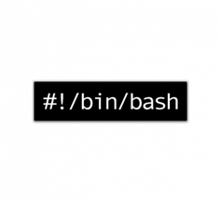

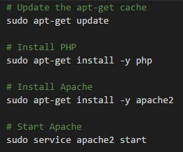
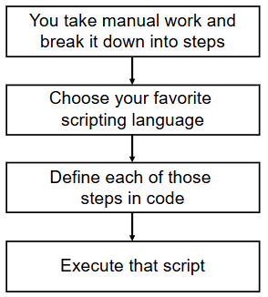
Ad-Hoc Scripts
The most straightforward approach to automating anything is to write an ad-hoc script
Notes:
Talking about Imperative..
Ad Hoc Scripts
This is where most organizations begin with Automation.
Typically written using scripting languages like Bash, PowerShell, or Python.
- The great thing about ad-hoc scripts is that you can use popular, general-purpose programming languages and you can write the code however you want.
- The terrible thing about ad-hoc scripts is that you can use popular, general-purpose programming languages and you can write the code however you want.

Slide 16

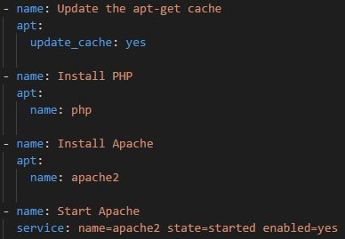

Configuration Management
Chef, Puppet, Ansible, and SaltStack are all configuration management tools, designed to install and manage software on existing servers.
Coding Conventions – Consistent & Predictable structure, file layout, clearly named parameters, secrets management, etc.
Idempotent Code – Execute the same code repeatedly while producing the same result.
Mutable Infrastructure – Infrastructure will be continually updated, patched, and turned to meet the ongoing needs of the purpose it serves.
Immutable Infrastructure – Immutable infrastructure is a paradigm where servers are never modified after they are deployed. Instead of updating or fixing existing servers, new servers are provisioned from a common image with the necessary changes and replace the old ones.
Notes:
Coding conventions – Enforces a consistent, predictable structure, including documentation, file layout, clearly named parameters, secrets management, and so on.
Idempotence
Code that works correctly no matter how many times you run it is called idempotent code.
Dive into Immutable vs Mutable.

Slide 17
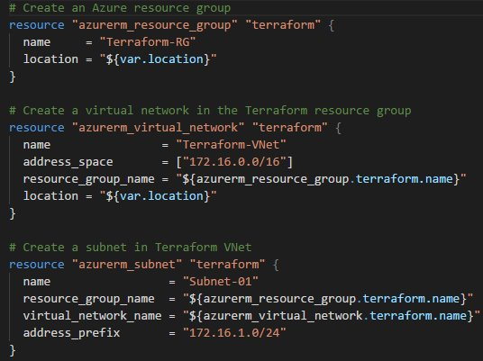




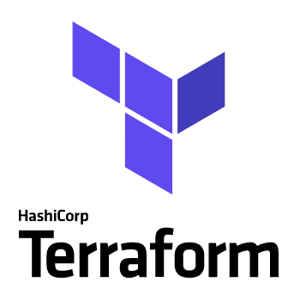


Server Provisioning Tools
Provisioning tools such as terraform, Azure ARM Templates, Bicep, AWS CloudFormation, OpenStack Heat, and more are responsible for creating the servers themselves.
You can use these tools not only create servers, but also other resources such as databases, load balancers, firewall settings, storage, etc.
A Tool for Every Job!!

Slide 18
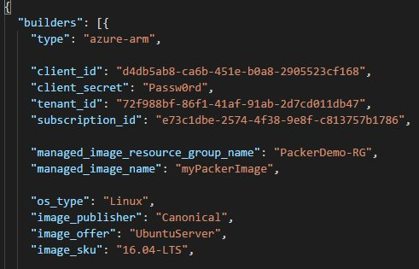


Server Templating\Imaging Tools
Growing in its popularity, are server templating tools such as Docker, Packer, and Vagrant.
Create an Image of a server that captures a fully-contained “snapshot” of the operating system, software, files, and configurations.
Server templating is a key component in the shift to immutable infrastructure.
Blue/Green deployment is a technique that reduces downtime and risk by running two identical production environments called Blue and Green.
Notes:
Talk about how Codespaces (lab environment) uses Docker and Dockerfiles to create a common toolset that can be used across workstations and environments.

Slide 19
Stages of Operational Maturity
Semi-Automated
Infrastructure is provisioned through a combination of UI/CLI and Ad-Hoc Scripts
Traceability is limited
Rollbacks are hard to achieve
Collaborative Maturity
Users across Organization can provision infrstructure, without conflicts and with clear understanding of their access permissions.
Full utilization of Modules and Templates across the build process.
Workspaces access control protect Production Environments.
Start
End
Manual
Referred to as ‘ClickOps’
Infrastructure is provisioned though UI or CLI.
Configurations changes do not leave a traceable history and are not always visible.
Limited or no naming standards.
Infrastructure as Code
Infrastructure is provisioned using IaC
Some (or most) provisioning and deployments are automated
Infrastructure config is consistent, details fully documented via code.
Source files are stored in Version Control
Some Modules are used to promote consistent reuse and architecture.
Notes:
Focus on how Operational Maturity is iterative.
Crawl, Walk, Run, and maybe even have to walk after you run.

Slide 20
LUNCH BREAK TIME
RETURN @ xxxxxx

Slide 21
Getting Started with Git
Notes:
“Can’t have GitOps without knowing Git”

Slide 22
Getting Started with Git
A little bit of history
Git was created by Linus Torvalds in April 2005 to develop Linux Kernel.
Replacement for bitkeeper to manage Linux Kernel changes.
What is Git.
A command line distributed version control solution.
Uses checksums to ensure Data Integrity.
Cross Platform(Including Windows).
Free & open-source control system.
What is Repository
Repo = Repository
Usually needs to organize a single project.
It contains folders, files, images, videos, spreadsheets and datasets --- anything your project needs.
Notes:
What is Git?
Talk about history of git and why a distributed VCS is better than centralized.

Slide 23
Configure Git
Name
The git config --global user.name configuration sets the name that will be associated with your commits in Git. This name is displayed in the commit history and helps identify who made each commit. It is particularly useful in collaborative projects to track contributions from different developers.
Email
The git config --global user.email configuration sets the email address that will be associated with your commits in Git. This email is displayed in the commit history alongside your name. It is used to identify the author of the commit and is often linked to your account on platforms like GitHub, GitLab, or Bitbucket to associate commits with your profile.
Line Endings
Line Endings (autocrlf): The core.autocrlf configuration in Git manages how line endings are handled between different operating systems. It is particularly useful when working in cross-platform environments (e.g., Windows and Linux). Here's how it works:
autocrlf = true: Converts line endings to LF (Linux/Unix style) when committing and back to CRLF (Windows style) when checking out files. This is recommended for Windows users working in cross-platform projects.
autocrlf = input: Converts line endings to LF when committing but does not modify them when checking out. This is recommended for Linux/macOS users to ensure consistent LF line endings.
autocrlf = false: Disables automatic line-ending conversion. Git will leave line endings as-is. This is useful if you want to handle line endings manually.
Full List of Git config options can be found at this link. https://git-scm.com/docs/git-config
Notes:
# DEMO #
Walk through ‘git config’ in terminal
- Show example of –local and how to configure –global.

Slide 24


Line Endings| Example
Add CR to EoL
Team uses Windows and Powershell
core.autoclrf = true
Remove CR from EoL
Git Repo used by both teams.
Team uses Linux, Mac or WSL primarily
core.autoclrf = input
Notes:
Explain why setting up autocrlf is so important!
Windows
When checking IN code – git should remove the Carriage Return from End of Line
When Checking OUT code – git should append the Carriage Return back to End of Line
Linux
When Checking IN code – git should remove Carriage Return if detected (example the editor is configured for CRLF vs LF)
When Checking OUT code – git should not add the Carriage Return and leave End of Line as is.

Slide 25
Common Git Commands
Git status: Display current status of git environment
Git init: Initializes a new Git repository.
Git clone: Creates a local copy of a remote repository.
Git add: Stages changes for the next commit.
Git commit: Saves staged changes with a message.
Git push: Uploads local commits to the remote repository.
Git pull: Fetches and merges changes from the remote repository.

Slide 26
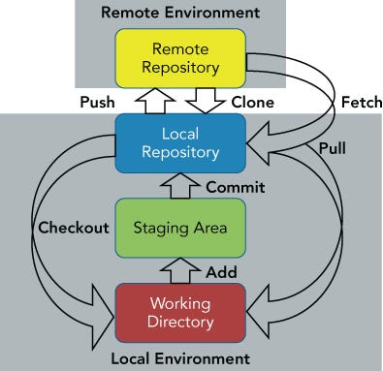
Git Workflow
‘git add <file>’
‘git commit’
‘git push’
‘git clone <repo>’
‘git checkout <branch>’
Notes:
Git workflow (whiteboard) and talk through what exactly is happening at each stage and with each command.
# DEMO #
- Create demo folder and files and walk through using ‘git status’ to show what git is doing.

Slide 27
Commit Best Practices
Commit Often but not too often (5-10 times a day is pretty typical). You should use commit to capture work in progress on features you are working on.
Commit should contain only 1 thing. If you are adding a new function/feature to your code and discover a bug or issue with something else. You shouldn’t fix the bug as part of your feature commit. Create a second commit for it so it is documented with its own commit and can easily be rolled back.
Teams should use consisted wording and format for commit messages. This will make code review much easier.
Commits should contain as much details as needed to explain not just what was changed but why.
Notes:
Focus on Commit should be 1 thing and consistent formatting of messages.
Show how short and long descriptions are created and examples of when to use.

Slide 28
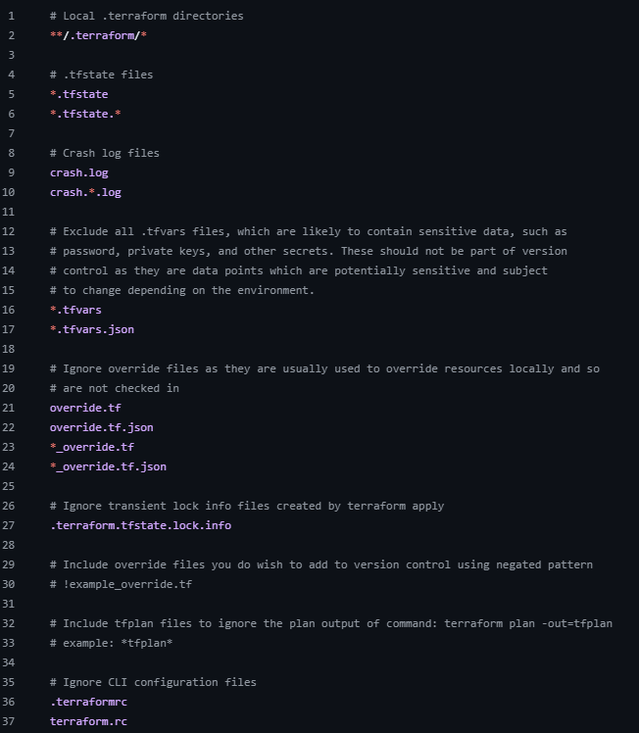
.gitignore
What is it?
The .gitignore file is used to specify which files or directories Git should ignore in a repository. This file helps in preventing sensitive, unnecessary, or local files from being tracked and committed to the Git repository.
Why is it important?
It ensures that unnecessary files (e.g., build artifacts, IDE configurations, temporary files) are not accidentally committed.
It protects sensitive files (e.g., credentials, passwords, or environment variables) from being pushed to a public repository.
It keeps the repository clean and manageable by only tracking source code and other necessary files.
Notes:
## DEMO ##
Create gitignore
Show how it can be used to “ignore” files
Show that you can’t ignore a file that has been committed
- walk through git rm –cache and demo once committed file being ignored.

Slide 29

Lab 01: Introduction to Git
Notes:
Lab should take around 20m to complete.

Slide 30
BREAK TIME

Slide 31
Docker
Notes:
Offer 5m break before diving in here.

Slide 32
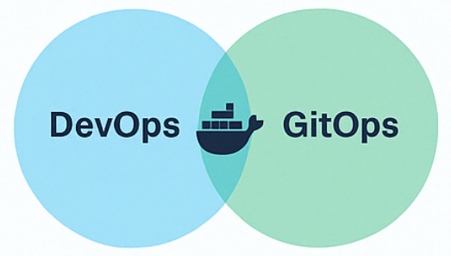
Why should Infra/Ops care about Docker?
“Why would an Infra/Ops person care about Docker? It’s a development too, right?
GitOps
Infrastructure-as-Code (IaC)
Automated Configuration Management
Automated Image Creation & Management
Docker Encompasses All of These:
Notes:
Focus on how Docker can be used to created unified toolbox for Operations teams.

Slide 33
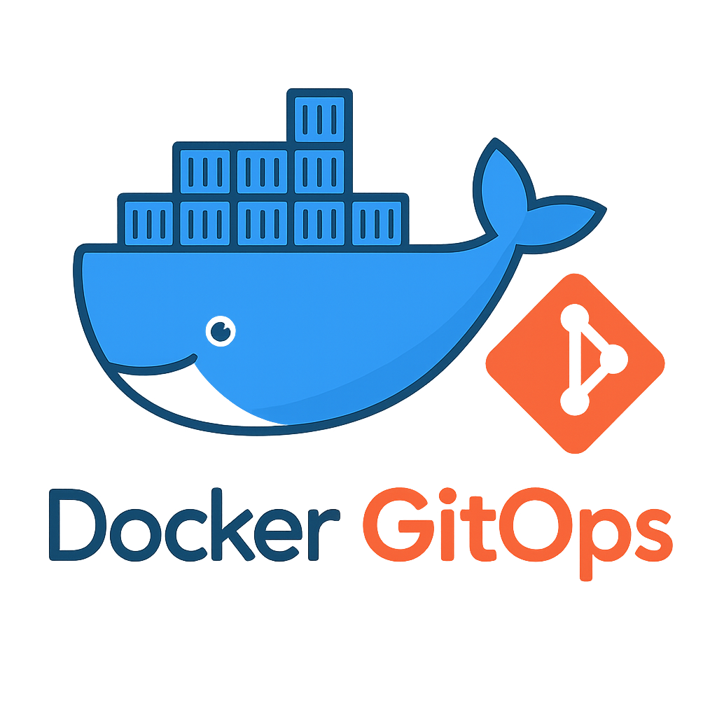
Benefits of Docker
Consistency Across Environments
Ease of Deployment
Unified Tooling
Microservice Architecture
Resource Efficiency
Portability
DevOps Integrations
Rapid Prototyping and Testing

Slide 34
Docker vs Virtual Machine
Aspect | Virtual Machines (VMs) | Docker Containers
Isolation | Provides full isolation with its own OS kernel. | Shares the host OS kernel, isolating at the process level.
Startup Time | Typically takes minutes to boot up. | Starts almost instantly (seconds).
Resource Usage | Heavier, as each VM includes a full OS image. | Lightweight, sharing OS resources efficiently.
Portability | Limited to the hypervisor and underlying hardware. | Extremely portable across different OS and environments.
Use Case | Best for running multiple OSes or isolated environments requiring full OS stacks. | Ideal for microservices and lightweight application deployment.
Notes:
It’s a common misconception when people are first introduced to Docker, but Containers are NOT virtual machines!
Talk through how docker shared kernel space and is running as an isolated “process” on the host.

Slide 35





Docker Terminology
Docker Image
The basis of a Docker container. Represents a full application
Dockerfile
A Dockerfile is a plain text file containing instructions to build a Docker image. This automates the process of creating Docker images, ensuring consistency and repeatability.
Docker Container
The standard unit in which the application service resides and executes
Docker Engine
Creates, ships and runs Docker containers deployable on a physical or virtual, host locally, in a datacenter or cloud service provider
Registry Service (Docker Hub or Docker Trusted Registry)
Cloud or server-based storage and distribution service for your images.
Such as Azure Container Registry

Slide 36

Docker Basics
Docker pull
docker pull <image-name>:<tag>
Docker images
docker images
Docker ps
docker ps
Docker run
docker run [options] <image-name>
Docker exec
docker exec [options] <container> <command>
Docker stop
docker stop <container>
Docker build
docker build –t <image-name> -f <dockerfile> .
Docker start
docker start <container>
Notes:
## DEMO ##
Pull ubuntu and run it
Build toolbox and run it
Talk through dockerfile

Slide 37
Lab 02: Docker
Notes:
Lab should take about 20m

Slide 38
Terraform

Slide 39
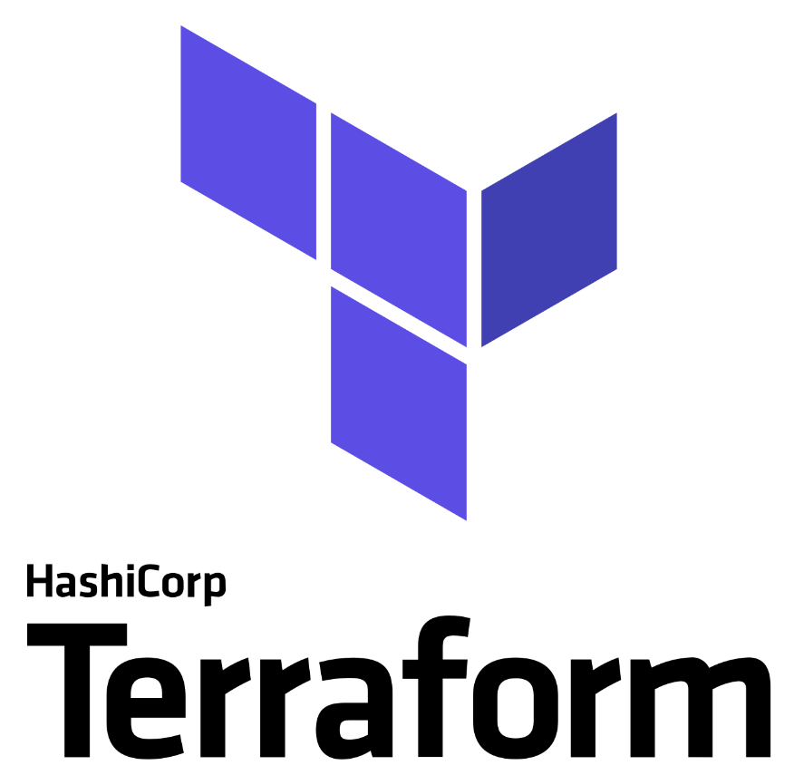

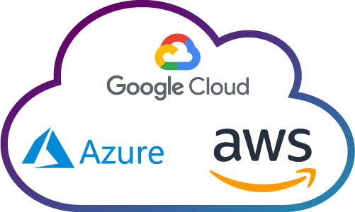
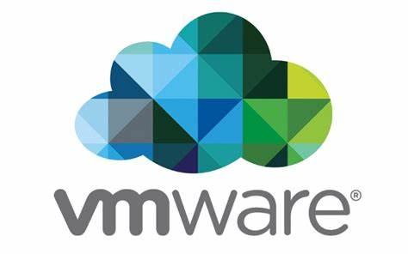
What is Terraform
Terraform is an open-source(ish) infrastructure as Code software created by HashiCorp.
Terrafrom allows users to manage and provision infrastructure
Resources including virtual machines, containers, and other cloud-based resources.
It’s designed to be used with a variety of cloud providers, including AWS, Azure, and GCP. It also supports many OnPrem solutions such as VMWare and OpenShift.
+
=
Notes:
HashiCorp switched Terraform's license from an open-source license to the Business Source License (BUSL)
Companies can’t include TF Binary in product without paying license fee. Otherwise nothing else changed.
This change has led to the creation of OpenTofu, a fork of Terraform that remains open-source, community-driven, and managed by the Linux Foundation (Eventually they’ll drift apart)
Large Organizations, your centralized operations team may get many repetitive infrastructure requests. You can use Terraform to build a self-service infrastructure model that lets product teams manage their own infrastructure independently.
Talk about how this can tie into Organization ITIL Solutions (example ServiceNow )
Terraform is Declarative. You tell it what you want and it figures out how to get that done.
Terraform is Idempotent. You can execute over and over and not impact anything.

Slide 40
Terraform Filename Conventions
A terraform module is a folder with one or more .tf files in it
The name of the files does not matter as long as it ends with .tf
Terraform loads all the .tf files into memory and combines them
Subfolders are ignored
There is a convention for variables and outputs, but there is no validation to enforce it
Variables: variables.tf
Outputs: outputs.tf
It also common to see the following convention:
Locals: locals.tf
Only one code file: main.tf
Terraform and provider blocks: terraform.tf

Slide 41
Terraform Syntax
terraform {
required_providers {
azurerm = {
source = "hashicorp/azurerm"
version = "~> 4.0"
}
}
}
provider "azurerm" {
features {}
}
resource "azurerm_resource_group" "example" {
name = "rg-demo"
location = "UK South"
}
Define providers
Defining providers tells Terraform which external platform you want to interact with.
Configure providers
Once a provider is defined, you configure it using a provider block.
type
name
Use provider resource
After defining and configuring the provider, you can use it to create and manage resources.
Parameters
Resource specific Parameters
After defining and configuring the Resource block, you need to add any required and/or optional parameters used to tell Terraform how to create the resource.
Notes:
This is the minimum amount of code required for TF to execute.

Slide 42
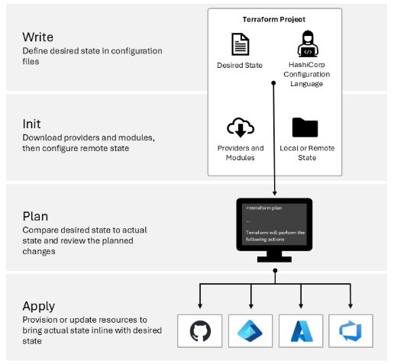
Terraform Workflow
Write your Terraform Code used to define your infrastructure state.
Terraform fmt (format) to clean up the code and give it a universal look and feel.
.terraform directory created
Backend is initialized
Modules and Plugins are downloaded
Comparison to current statefile (if any)
Creates Execution plan and displays as Output to user
Basic validation that Code will run without errors (not perfect)
Execution of Code and calls backend APIs happen here
State is locked while apply is running as it is being modified.
Notes:
Terraform is designed and should be used to manage the lifecycle of your resources.
By using tfstate and tfplan, Terraform can manage your resources through these stages:​
Tfstate should be stored remote
Tfpan should be tossed after each execution.
Don’t EVERY commit .terraform directory – talk about LFS issue.

Slide 43
Terraform Formatting
terraform {
required_providers {
azurerm = {
source = "hashicorp/azurerm"
version = "~> 4.0"
}
}
}
provider "azurerm" {
features {}
}
resource "azurerm_resource_group" "example_one" {
name = "rg-demo-01"
location = "UK South"
tags = {
environment = "Demo"
}
}
resource "azurerm_resource_group" "example_two" {
name = "rg-demo-02"
location = "UK South"
tags = {
environment = "Demo"
}
}
Run terraform fmt to follow standard formatting guidelines
Indentation
Alignment
Brace position
Etc

Slide 44
Terraform Locals
Locals can be used to avoid duplicated code
Locals can be used to make calculations
Locals block is plural
resource "azurerm_resource_group" "example_one" {
name = "rg-demo-01"
location = "UK South"
tags = {
environment = "Demo"
}
}
resource "azurerm_resource_group" "example_two" {
name = "rg-demo-02"
location = "UK South"
tags = {
environment = "Demo"
}
}
locals {
prefix = "rg-demo"
location = "UK South“
tags = {
environment = "Demo"
}
}
resource "azurerm_resource_group" "example_one" {
name = "${local.prefix}-01"
location = local.location
tags = local.tags
}
resource "azurerm_resource_group" "example_two" {
name = "${local.prefix}-02"
location = local.location
tags = local.tags
}
Refactor
Local ref is singular
NOTE: terraform and provider block hidden for brevity, but still required
Notes:
Terraform locals allow you to define intermediate, reusable expressions within your Terraform configurations.

Slide 45
Terraform Variables
Variables make Terraform code re-usable
Variables supply values at plan time
Variable block
variable "location" {
type = string
default = "UK South"
}
variable "prefix" {
type = string
default = "rg-demo"
}
locals {
tags = {
environment = "Demo"
}
}
resource "azurerm_resource_group" "example_one" {
name = "${var.prefix}-01"
location = var.location
tags = local.tags
}
resource "azurerm_resource_group" "example_two" {
name = "${var.prefix}-02"
location = var.location
tags = local.tags
}
locals {
prefix = "rg-demo"
location = "UK South"
tags = {
environment = "Demo"
}
}
resource "azurerm_resource_group" "example_one" {
name = "${local.prefix}-01"
location = local.location
tags = local.tags
}
resource "azurerm_resource_group" "example_two" {
name = "${local.prefix}-02"
location = local.location
tags = local.tags
}
Refactor
Use var to reference
Notes:
Terraform variables allow you to parameterize your configurations so that you can reuse the same code in different environments, regions, or projects without hardcoding values over and over again.
- Discuss when hardcoding is acceptable and why it shouldn’t be used too much

Slide 46
Terraform Variables Precedence
If a variable name matches, then the lower down inputs take precedence
Environment variables
terraform.tfvars file, if present
terraform.tfvars.json file, if present
Any *.auto.tfvars or *.auto.tfvars.json files, processed in lexical order of filenames
Any -var and –var-file options on the command line, in the order provided
Notes:
EnvVars
A variable value can be specified with TF_VAR_<variable_name> = <variable_value>
The environment must begin TF_VAR_ and the variable name must match exactly
Tfvars files
A tfvars file can be used to supply variable values
A tfvars file is HCL or JSON format
HCL file extension is .tfvars
JSON extension is .tfvars.json
Some tfvars file names and patterns are automatically discovered by Terraform
terraform.tfvars and terraform.tfvars.json
*.auto.tfvars and *.auto.tfvars.json
Any other tfvars file must be specified on the command line with -var-file="example.tfvars"
Inline/CLI
A variable value can be specified with -var="<variable_name>=<variable_value>"
Many -var flags can be specified in a single command

Slide 47
Terraform Outputs
Outputs can be used to get data from Terraform and pass to other processes
Use the terraform output command to read outputs
...
resource "azurerm_resource_group" "example_one" {
name = "${var.prefix}-01"
location = var.location
tags = local.tags
}
resource "azurerm_resource_group" "example_two" {
name = "${var.prefix}-02"
location = var.location
tags = local.tags
}
output "resource_group_ids" {
value = {
example_one = azurerm_resource_group.example_one.id
example_two = azurerm_resource_group.example_two.id
}
}
Output block
> terraform output
> terraform output -json
> terraform output -json resource_group_ids
Must set value
Notes:
When you're building infrastructure with Terraform, it's often useful to get key information out of your configuration once the resources are created. Talk about how to leverage it CI/CD.
Talk about using tf output to build dynamic inventory for things like Ansible..

Slide 48
Terraform Console
Terraform console is part of Terraform CLI.
It can be used to test expressions and interrogate code
Type terraform console to enter the console context
pwsh: terraform console
> 1 + 1
2
> "test ${ 1 + 1 }"
"test 2"
> exit
pwsh:
Type expressions, then hit enter to see the result on the next line
Type exit or Ctrl + C to exit the console context
If your current working directory has an initialized Terraform project and a state file (terraform.tfstate), the console has access to real values from your deployed infrastructure – great for debugging and advanced usage.
Notes:
## DEMO ##
Demo this via terminal!
Create simply tf with outputs so you can show how it leverages outputs if in same directory.

Slide 49
Terraform Types
What are data types and why do we need them?
What are types
Types are data types, like the data types in any other languages. Terraform supports simple primitive types, collection types, complex types and dynamic types.
Where can types be specified
Types can only be specified in variable block declarations. You cannot specify a type for a local.
Why use types
Types let your module user what data type is expected for a particular variable. They provide fast validation feedback when an incorrect type is supplied. Knowing what type is allowed for a variable makes it simpler to handle in the rest of your code as no extra checking is required.
Notes:
## DEMO ##

Slide 50
Terraform Expressions
What are expressions and why do we need them?
What are expressions
Terraform HashiCorp Configuration Language (HCL) is fundamentally a declarative language. However, it is more than a data serialization language like XML, JSON or YAML. HCL is Domain Specific Language (DSL) that that builds on top of a static configuration like JSON, using expressions to provide great flexibility. An expression in HCL is the same concept as in other language, such as C# or Go. An expression is a logical operation, calculation, or iteration.
Why do we need expressions
Expressions allow you to build logic into your Terraform code. Thereby enabling you to change its behavior based on inputs. This is crucial to being able to re-use the same code in multiple environments. Expressions also allow you to keep your code simple and extensible, avoiding repetition.
What does an expression look like
In its most simple, an expression is a literal:
"hello world" is a string literal and
5 is a number literal.
Another example is string interpolation: "${local.hello} world"
Notes:
## DEMO ##

Slide 51
Terraform Functions
What are functions and why do we need them?
What is a function
Functions are built into the Terraform core language. They behave like functions in any other language with input parameters and an output.
We also now have provider defined functions that are built into a provider and usually perform domain specific calculations, such as Azure resource IDs.
Where can functions be used
Functions can be used inside any expression. For example with the lower function:
example = "Hello ${lower(var.world)}"
example = lower(var.world)
example = [ for value in var.worlds : lower(value) ]
Why do we need functions
The Terraform language contains standard arithmetic and comparison operators, but to achieve anything more advanced functions are required.
Functions enable handling advanced scenarios inside Terraform, meaning that input data does not have to be pre-manipulated in most cases.
Notes:
## DEMO ##

Slide 52
Terraform Iteration Fundamentals
What is iteration and why do we use it?
What is iteration
Iteration allows us to manage collections of similar resources or resource attributes in Terraform. It leverages the count, for_each, for, and dynamic key words depending on where it is used.
Why use iteration
Iteration avoid the need to copy and paste code for the same resource type or resource attribute. It means we can declare once in our code and use variables and locals to define how many and what attributes each should have. It keeps our code clean and maintainable.
Notes:
## DEMO ##
Use TF to spin up a simple Windows and Linux VM on DEMO VNET with either VPN or Bastion prestaged.
Cover init and show what is in .terraform folder
Cover FMT | let it fix tabbing and formatting
Cover TFPLAN
Cover TFSTATE | CAT statefile to show it has sensitive data
Cover OUTPUT | Output Ids and Ips to create inventory file later.

Slide 53
Implicit and Explicit Dependencies
When Terraform changes infrastructure, many of the changes must be made in a specific order.
This order is determined by resource dependencies.
Implicit Dependencies
Terraform determines dependencies automatically based on configuration references
One resource referencing another resource builds an implicit dependency
Explicit Dependencies
User defined using depends_on meta argument
This should only be done when there is not way to build an implicit dependency
Notes:
Important concept to understand!!

Slide 54
Terraform State
Terraform must store state about your managed infrastructure and configuration.
Local state
Stores the state file locally as terraform.tfstate
Manages and updates the state file on the local machine
Remote state
Stores the state file in a remote data store, such as Azure Blob storage
Allows sharing with team members
Local state is fragile and not fit for production – or anything outside the local environment.
Notes:
Talk about state and protecting the sensitive data in it.

Slide 55
Terraform Workspaces
Provides a way to separate out .tfstate files by their own space/directory
Similar to feature branches in version-control
Provides isolation during plan, apply and destroy
Initially, Terraform creates just one workspace called default
Remote backends such as AzureRM support multiple workspaces
Workspaces do not warrant complete isolation use-cases. See:
State: Workspaces | Terraform | HashiCorp Developer
Notes:
Terraform workspaces and how they help manage multiple environments within the same configuration.
## DEMO ##

Slide 56
Terraform Provisioners
Can be used to model specific actions on the local machines or on a remote machine, in order to prepare servers or other infrastructure objects for service. Can also be used with terraform_data.
Introduced in Terraform, as a measure of pragmatism, knowing that there will always be certain behaviours that can’t be directly represented in Terraforms declarative model.
Built-in Provisioners
Local exec
Executes commands on the machine running Terraform. Useful for scripts or commands that need to be executed locally.
Remote exec
Executes commands on a remote machine. Typically used to run configuration management tools or scripts.
Use Provisioners as a last resort, as they add complexity and uncertainty!!
Notes:
Discuss what provisioners are in Terraform and explore the built-in provisioners: local-exec and remote-exec.
## DEMO ##
local-exec

Slide 57
Lab 03: Terraform
Notes:
Lab should take around 30m to complete.

Slide 58
BREAK TIME

Slide 59
Ansible

Slide 60
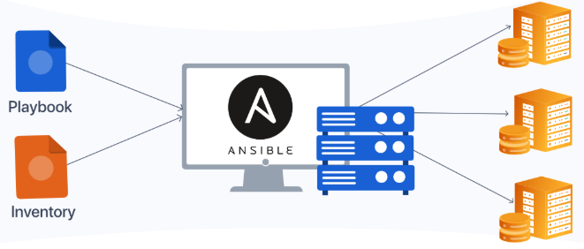
What is ansible
Ansible is an open-source automation platform from Red Hat that allows you to configure systems, deploy applications, and orchestrate infrastructure. It uses YAML-based playbooks to define tasks and configuration, and connects to remote systems over SSH (or WinRM for Windows) — no agent installation is required on target machines.
Ansible is designed to be simple, human-readable, and highly extensible, making it ideal for both ad-hoc operations and repeatable automation at scale. It supports a wide range of platforms including Linux, Windows, cloud providers (Azure, AWS, GCP), containers, and networking equipment.
Notes:
Ansible is an open-source automation tool for configuration management, application deployment, and task automation, known for its simplicity, agentless architecture, and use of YAML.
Talk pro/con of Push (agentless) over Pull (agent) methods
Talk about how to Ansible on Windows

Slide 61
Why Use Ansible
Ansible is simple, powerful, and easy to learn with human-readable YAML syntax.
It requires no agents on managed hosts, relying instead on SSH or WinRM for communication.
You can automate repetitive tasks like package installation, user management, or service restarts across thousands of machines.
Ansible playbooks promote consistency and reduce human error by codifying infrastructure and application logic.
It's cloud-agnostic and supports hybrid environments — from bare metal to Azure, AWS, containers, and network gear.

Slide 62
Ansible Key Concepts
“Playbooks are at the heart of Ansible. They define what you want to do and how to do it. Think of them like recipes—written in YAML—that describe steps like installing software, copying config files, or restarting services.”
“Inventory files are how Ansible knows which systems to talk to. These can be static INI/YAML files or dynamic sources like Azure or AWS. You can group servers—like ‘web’ or ‘db’—to target different roles in your automation.”
“Modules are like building blocks. Ansible has thousands of modules—think yum, apt, copy, template, etc.—each performing a specific action on the system. These are what actually do the work inside each playbook task.”
“Variables make playbooks reusable. Rather than hardcoding values like usernames, paths, or regions, we define variables and pass them in—making it easy to adapt the same playbook for dev, test, or prod.”
“Roles help you scale your automation. They provide a folder structure that makes it easy to reuse tasks, handlers, templates, and vars. Great for sharing code across teams and breaking large playbooks into clean, manageable chunks.”
Notes:
Spend time talking through each of these concepts.

Slide 63
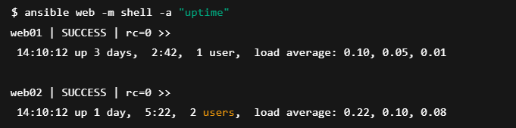
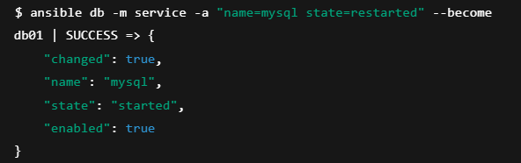
Ansible Ad-Hoc Commands
Run one-off tasks across multiple server without writing a playbook
Great for quick operations like checking connectivity or installing packages
Common for ping tests, reboots, package installs, or service restarts
Ideal for fast troubleshooting or admin tasks without long-term restarts.
Uses command-line syntax:
Ansible [hosts] –m [module] –a “[args]”
Notes:
Ansible Ad-Hoc commands are a powerful feature for executing quick, one-time operations across many systems — without writing a full playbook.
## DEMO ##

Slide 64
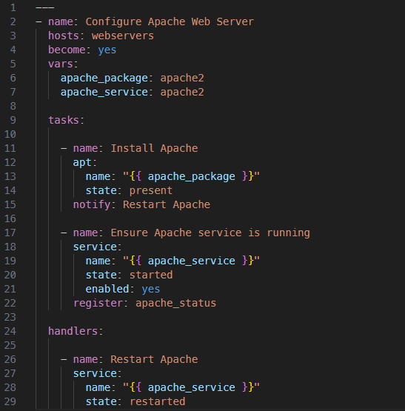
Ansible Playbook Structure
Module Name
Variables
Task Name
Module Name
Module Arguements
Directives
Handler
Notes:
Talk about each component in a playbook.

Slide 65
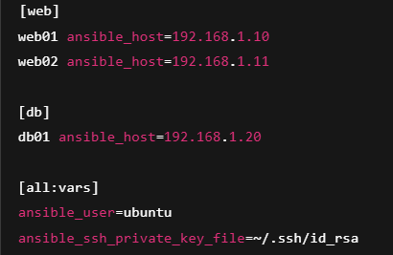
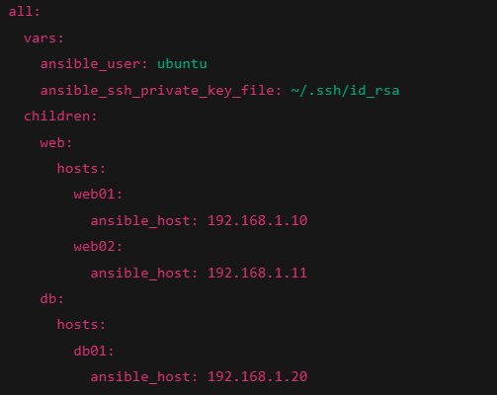
Inventory File Structure
Group Vars
Host Group Name
Host Name
Host Address
Notes:
Cover the fact it can be done with YAML or INI.
## DEMO ##
Create basic playbook and inventory file (should have prestaged infra for this part using TF demo above)
Walk through installing IIS and Configuring Windows.
Show idempotency by altering Admin group manually and having ansible undo that change.
Walk through installing Apache on Linux
Customize .conf and HTML
Alter apache .conf file and use ansible to fix it.
Show process for updating HTML

Slide 66
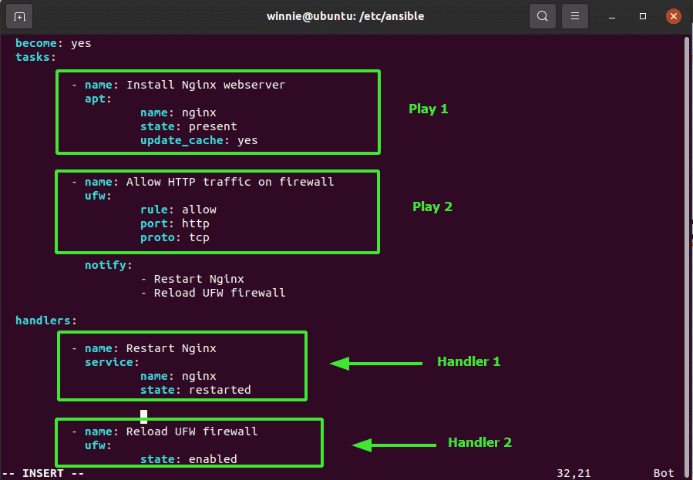
Handlers and Notifications
Notes:
Talk through this slide. Important concept to understand.
Tasks Section
Play 1 – Install Nginx Webserver
Uses the apt module to install Nginx.
Includes parameters: name, state, and update_cache.
This is a basic package installation task.
Play 2 – Allow HTTP traffic on the firewall
Uses the ufw module to open port 80 (HTTP) with rule: allow, port: http, and proto: tcp.
This task notifies two handlers: one to restart Nginx and one to reload UFW.
Notify
The notify: keyword tells Ansible to run the specified handlers, but only if the task changes something (i.e., results in a state change).
Handlers Section
Handler 1 – Restart Nginx
Uses the service module to restart Nginx.
Triggered only when one of the tasks that notify it makes a change.
Handler 2 – Reload UFW firewall
Uses the ufw module again but in a handler context, ensuring firewall rules are applied after any change.

Slide 67
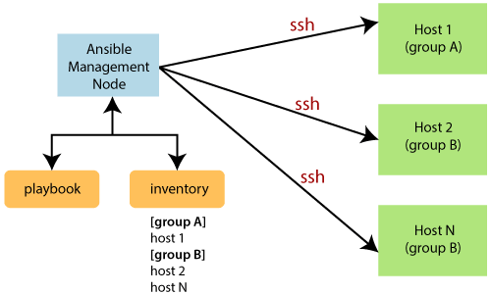
Ansible and GitOps
Notes:
In a GitOps workflow,
Ansible serves as the engine that applies configuration and operational changes defined in Git.
While Git holds the declarative source of truth—like playbooks, inventories, and templates—Ansible executes those definitions against real infrastructure.

Slide 68
Lab 04: Ansible

Slide 69

Q&A

Slide 70
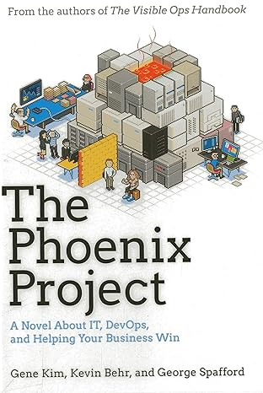

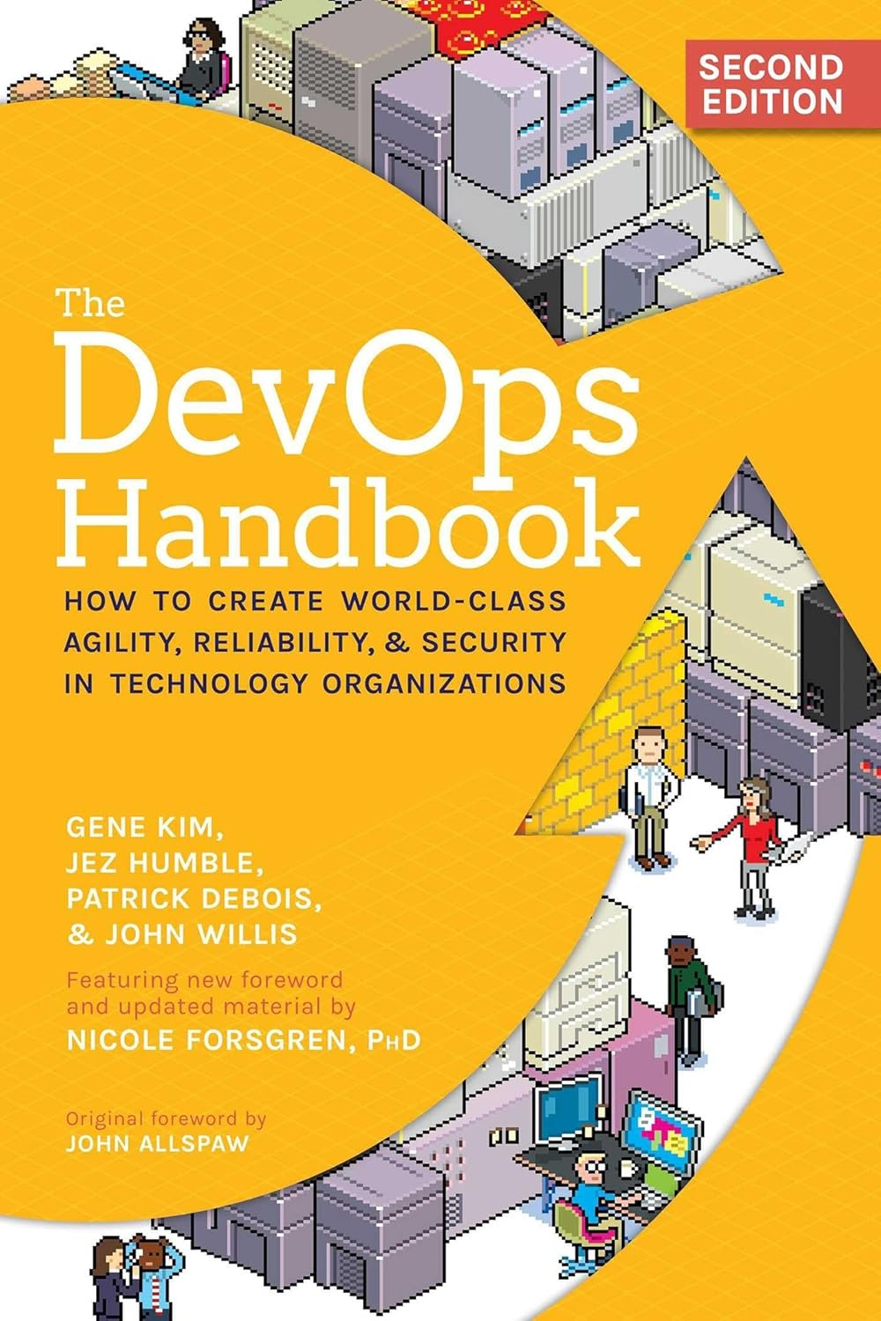
Recommended Reading
Notes:
Recommended reading for people entering DevOps for the first time!

Slide 71



Contact Info
bemitchell@microsoft.com
https://linkedin.com/in/benmitchell1979
Benjamin Mitchell
Microsoft Senior CSA

Slide 72

Thank you

